Slide 1

Sales Dataset Analysis – Advanced Excel Project Devadharshini.v 12.12.2024 Data analytics & Data Science Oct 2024(regular)

Slide 2
Project Overview
OBJECTIVES
Analyze sales trends over time.
Identify high-performing products and sales channels.
Determine the impact of returns and discounts.
Create a dynamic dashboard with key metrics.

Slide 3
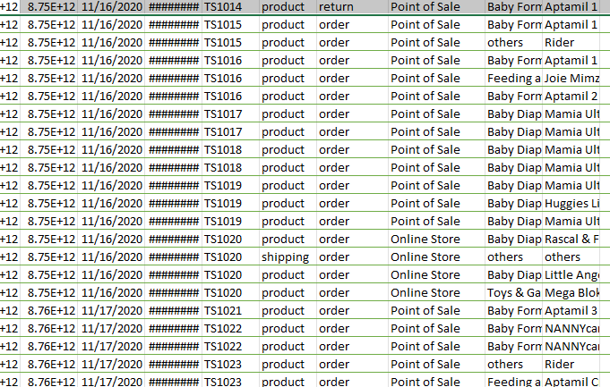
Data Set Overview
Data Cleaning
Removed Blank Rows, Duplicate Rows and Splited columns.
Cleaned Using Power Query

Slide 4
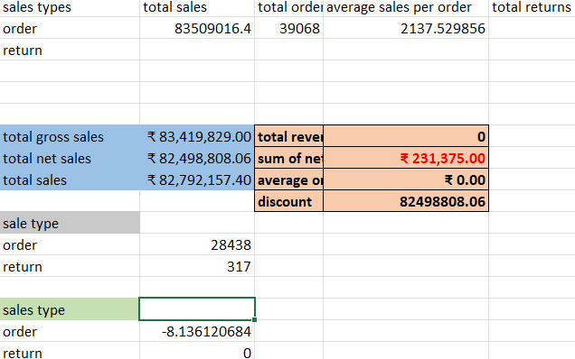
Important Calculations
Total sales (Gross, Net, Adjusted)
Average sales per order
Discount rates, return rates
Sales by channel/product type

Slide 5
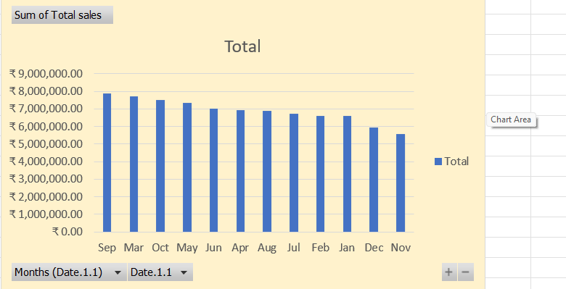
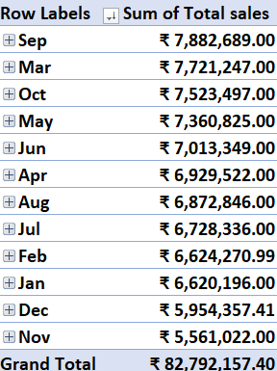
Pivot tables and charts

Slide 6

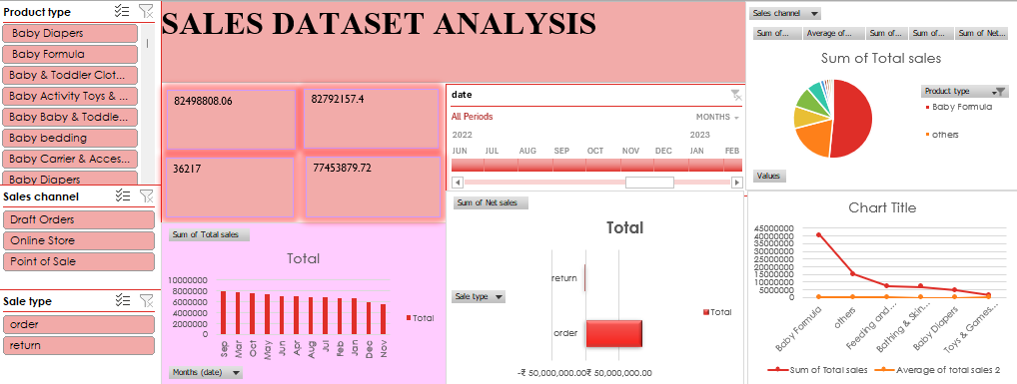
Dashboard

Slide 7
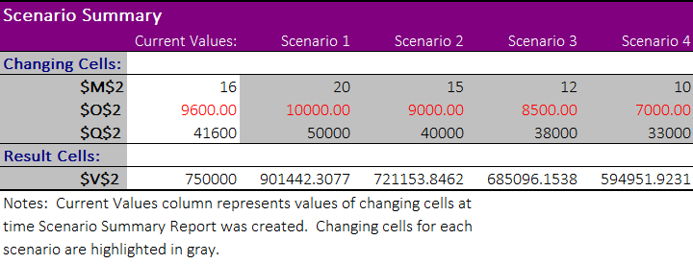
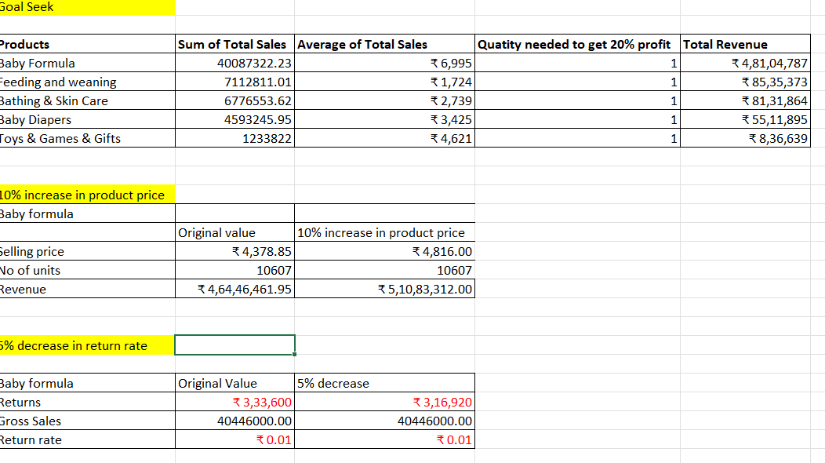
What if analysis and goal seek

Slide 8
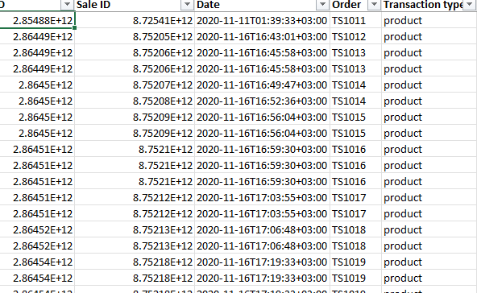
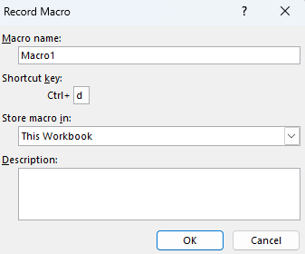
MACROS

Slide 9

Insights
Top selling Products are Baby Formula followed by feeding and weaning.
Seasonal Peak is in September
Gradually sales increased year by year.
Comparing Online and Offline sale, Sales increased in Offline.

Slide 10
Conclusion
In this Analysis, BABY FORMULA is sold more compared to other products mainly in September month.
We can focus on the bottles and bottling sets by giving discounts or offers.
In future we should increase the products quality to grab more customers.

Slide 11

Thank you

